Slide 1
Fake News Detection Project
FlipRobo Technology
By, Utkarsh Vardhan

Slide 2
Background and Problem Statement:
The authenticity of Information has become a longstanding issue affecting businesses and society, both for printed and digital media.
On social networks, the reach and effects of information spread occur at such a fast pace and so amplified that distorted, inaccurate, or false information acquires a tremendous potential to cause real-world impacts, within minutes, for millions of users.
Recently, several public concerns about this problem and some approaches to mitigate the problem were expressed.
In this project, you are given a dataset in the fake-news_data.zip folder.
The folder contains a CSV files train_news.csv and you have to use the train_news.csv data to build a model to predict whether a news is fake or not fake.

Slide 3
Business Goal
Data cleaning and text exploration & Focus on data visualization and infer details from it.
Used 3 models for training to finalize the model.
Test the predictions on metrics such as Accuracy

Slide 4
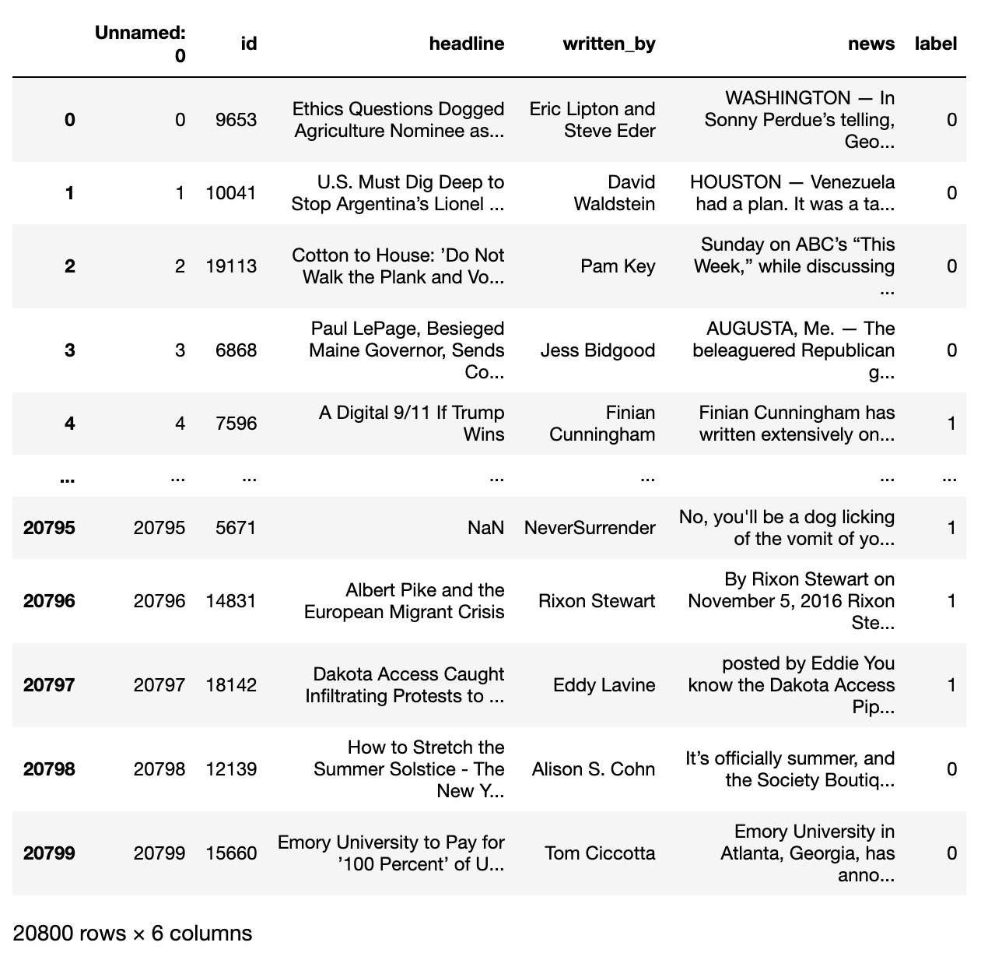
Data Shared
There are 6 columns in the dataset provided to you. The description of each of the column is given below
“id”: Unique id of each news article
“headline”: It is the title of the news.
“news”: It contains the full text of the news article
“Unnamed:0”: It is a serial number
“written_by”: It represents the author of the news article
“label”: It tells whether the news is fake (1) or not fake (0).
Shape of the data 20800 rows , 6 columns.
Data Types : 3 features Int64 and other 3 are object.
Data contains missing values under the features Headlines and Written-by

Slide 5
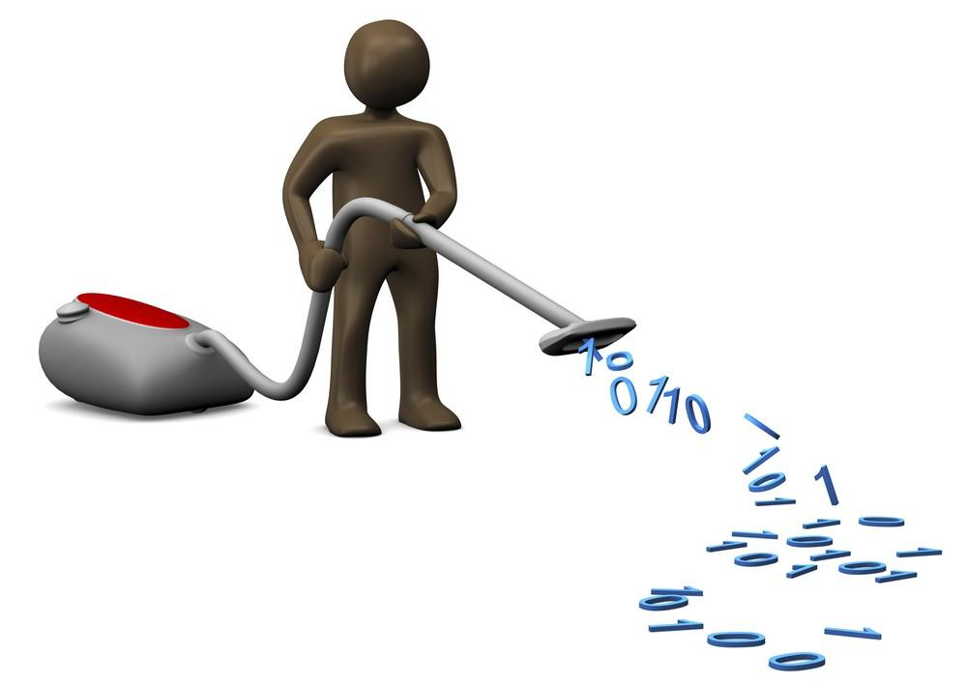

Data Cleaning
Removal of special Characters
Concatenation of Texts
Dropping Rows Columns
Checking Missing Values
Dropping Rows
Checking Uniqueness
Checking Shapes and Data Types

Slide 6
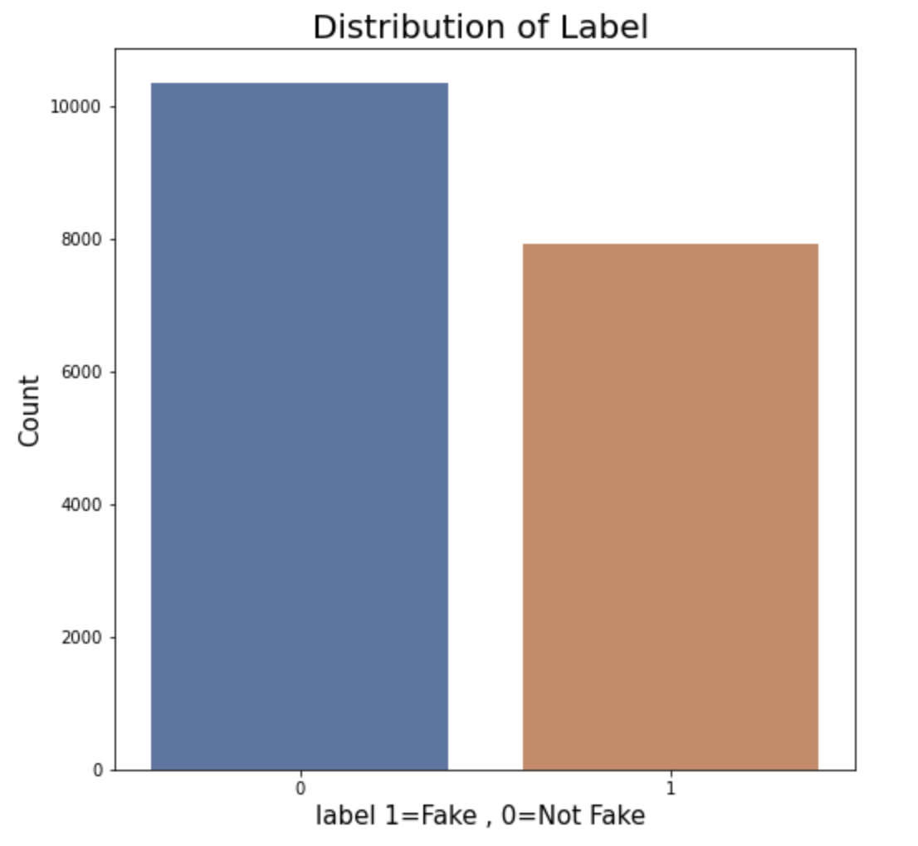
Data Visualization:
Distribution of the News :
Label 1 = Fake
Label o = Not Fake
About 8000 news reported as fake as per our data where 60 % of the data is not Fake.
Distribution of the data is somewhat equally distributed.

Slide 7
Data :
Text Structuring
CountVectorizer
Creating Bag Of Words (BOW)
Stemming
Remove stopwords
Convert everything to lowercase
Remove special characters
Remove HTML tags

Slide 8
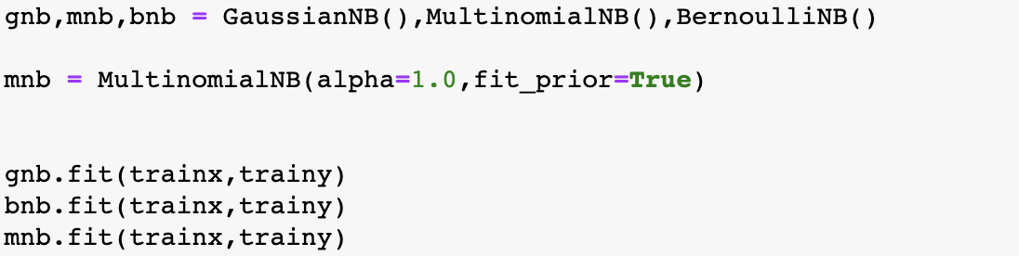
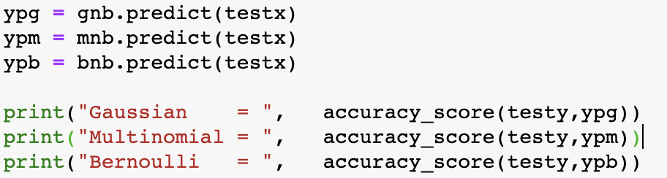
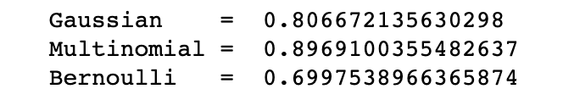
Defining the Models with the prediction:
Test Result:

Slide 9
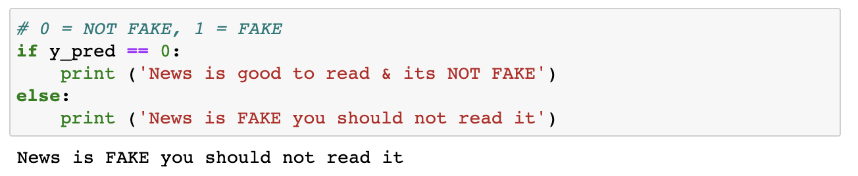
Conclusion:
As per our modulation , we saw that all three models i.e Gaussian, Multinomial and Bernoulli were trained well.
The best model is opted as Multinomial as it shows the most Accuracy which is 89.69% which is more than any other.
The next best model is Gaussian Model which shows the accuracy around 81%.
The below code shows the detection of the News weather it is fake or Not fake.
By this project I am able to predict mostly 90 % accurately weather the News is Fake or Not.

Slide 10
Thank You : )

